Slide 1
MVVM made simple with Prism and Xamarin.Forms
Dutch Mobile .NET Developers November 23, 2017

Slide 2


Bart Lannoeye
Senior .NET Consultant @ Sirus
AppCreativity
Board member MADN
Microsoft
MVP Windows Development
MEET Belgium
@bartlannoeye

Slide 3

What is Prism?
XAML Application Framework
Guidance
Patterns & Practices
Testable & Maintainable
Open Source: http://github.com/PrismLibrary
.NET Foundation
Notes:
Prism WPF since 2008

Slide 4
What do you get?
MVVM Support
Commanding
Messaging
Navigation
Page Dialog Service
Logging
Dependency Injection
Visual Studio Project and Item Templates
Notes:
Template Pack: https://marketplace.visualstudio.com/items?itemName=BrianLagunas.PrismTemplatePack

Slide 5
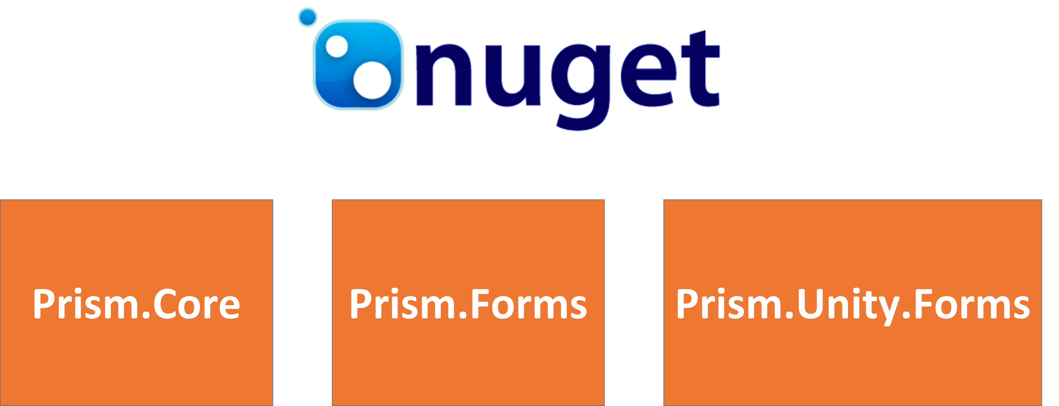
Where do you get Prism?
Notes:
Forms: Navigation / Dialogs, …

Slide 6
MVVM Support

Slide 7
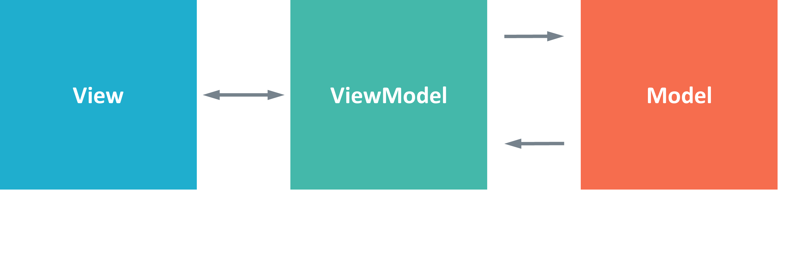
What is MVVM?
Design pattern
Question: how to connect Binding context and ViewModel?
Notes:
Real problem is binding vm to view
Messaging, events, … in all types of coding, even in winforms with code behind
Possible solutions:
- code behind
- xaml
- viewmodel locator
> static class, add properties for each view

Slide 8
Making the connection
ViewModelLocator
Automatic ViewModel Construction and Wire-up
AutowireViewModel Attached Property
Convention Based
“Views” namespace
“ViewModels” namespace
View Name + “ViewModel” = ViewModel Name
MainPage + “ViewModel” = MainPageViewModel
Notes:
possible solutions:
- code behind
- xaml
- viewmodel locator
static class, add properties for each view
create vm through container

Slide 9
Commanding

Slide 10
Commanding
DelegateCommand / DelegateCommand<T>
CanExecute
RaiseCanExecuteChanged();
ObservesProperty
ObservesCanExecute
DelegateCommand.FromAsyncHandler
DelegateCommand<T>.FromAsyncHandler
Notes:
PRoblem: CanNavigate not updated
Most commands:
Command.RaiseCanExecutechanged in property
=> observesproperty // chain observesproperty
=> observescanexecute

Slide 11
Navigation

Slide 12
Better navigation
Decoupled Navigation
No Page references
No ViewModel references
Based on URIs ( = strings )
Relative (default) – navigation occurs relative to calling VM
Absolute – replaces entire navigation stack
Pages must be registered for navigation
INavigationService
Navigate
GoBack
Notes:
xamarin forms navigation depends on a page
no vm reference: between projects that don't have references
relative navigation
master detail > to details
content page > another page
absolute application.current.mainpage
INavigationService must be called navigationService because XF demands so because it uses parameter override which happens by name
> 100% testable vm because of interface

Slide 13
Navigation: passing parameters
Use NavigationParameters
Dictionary of objects (Key/Value)
Use querystring
Pass parameters via INavigationService
Navigate
GoBack

Slide 14
Navigation: view/viewmodel participation
INavigationAware
OnNavigatedTo
OnNavigatedFrom
IConfirmNavigation
CanNavigate
IConfirmNavigationAsync
CanNavigateAsync

Slide 15


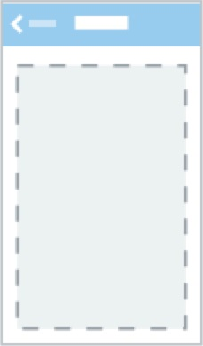
Deep linking
Navigate(“MasterDetail/NavigationPage/ViewA/ViewB”);
View A
View B
Notes:
animated false for deep links

Slide 16
Deep linking with parameters
Navigate(“MasterDetail?id=4/NavigationPage/ViewA?user=bart/ViewB?sort=asc”);
id=4 user=bart sort=asc
View A
View B

Slide 17
Messaging

Slide 18
IEventAggregator
Loosely coupled, event based communication
Multiple publishers & subscribers
Pass parameters/payloads
Filter events
They’re weak events
Notes:
xamarin forms messaging center : still static => testability

Slide 19
What’s next?

Slide 20
Prism.Forms v7 (prerelease)
.NET Standard support
Support for MacOS
Manipulate navigation stack
Remove pages
GoBackToRoot
OnPlatform specific navigation
Dynamic tab generation
…

Slide 21
Wrapping up
@bartlannoeye http://github.com/PrismLibrary

